Slide 1
Medical Nutrition Therapy for Traumatic Brain Injury
Christina Dinger, Dietetic Intern

Slide 2
Learning objectives
Develop a basic understanding of traumatic brain injury.
Identify nutritional implications during the various stages following a traumatic brain injury.
Determine the appropriate route of nutrient delivery.
Discuss ways to determine adequate calorie and protein needs for patients with traumatic brain injury.

Slide 3
Background
Holy Spirit Hospital is in preparation to become a certified trauma center in fall 2016.
Increase in trauma patients and increase in severity of cases.
Dietitians will need to be knowledgeable in the correct provision of care this population requires.
How might nutrition be impacted in these patients?

Slide 4
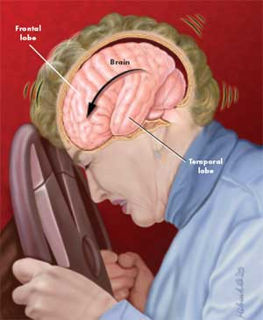
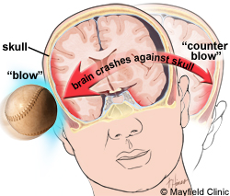
Statistics
According to Brain Trauma Foundation – approx. 2.2 million cases of TBI yearly.
How is a TBI caused?
External force to the head
Frequent movement where the brain repeatedly comes in contact with the skull

Slide 5
Statistics
When might these instances occur?
Motor vehicle accidents, falls, sports, assault of violence, contact with forceful object
Who is affected by a TBI?
Men and Women
Increased likelihood in men
What age groups have the highest occurrences?
Children under 4
Elderly over 65
Due to increased falls
Individuals between the ages of 14-34 are likely to experience TBI as a result of a motor vehicle accident.

Slide 6
How to determine Severity of TBI
Glascow Coma Scale
Tool assesses ranges of functions, score is gathered from each category, then level of consciousness and severity is determined based on overall score.
Rating of 3-8 is considered severe
Rating of 9-12 is considered moderate
Rating of 13-15 is considered mild

Slide 7
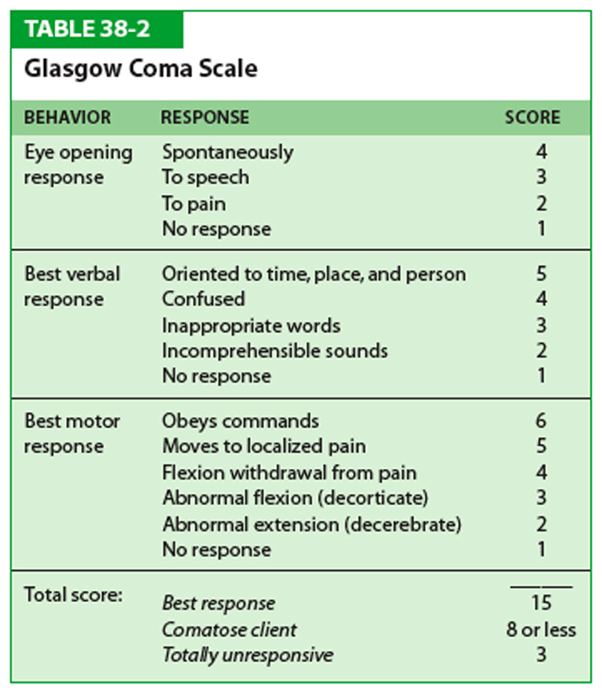
Glascow Coma Scale

Slide 8
How is nutrition status impacted?
Hypermetabolic, Hypercatabolic
Due to increased presence of hormones that are released as the body’s response to inflammation.
Cytokines
This state can increase the patient’s risk for malnutrition
Increased risk for gastrointestinal issues
Delayed gastric emptying, increased gastric residuals, diarrhea, abdominal distention, pneumonia related to aspiration

Slide 9
How is nutrition status impacted?
Roberts and Touger-Decker
Impaired gastric motility due to increased intracranial pressure, increased presence of hormones, vagal nerve suppression, hyperglycemia and increased cytokines
Painter et. al.
Increases metabolism and nitrogen loss
Increases calorie and protein needs
Due to inflammatory response to injury
Digestive system changes
Gut bacteria released into circulation as a result of increases gut permeability
Can cause increased infection

Slide 10
Preferred route of nutrient delivery
PO intake is always the preferred route
Second route is enteral if the patient is mechanically ventilated and will be unable to orally consume adequate calories for a significant period of time.
Most patients will be considered critically ill, mechanically ventilated and admitted to the intensive care unit.

Slide 11
When should feeding be initiated?
American Society of Parenteral and Enteral Nutrition suggests early enteral nutrition administration positively impacts survival rates.
Decreases infections and complications related to hypermetabolic/hypercatabolic state
24-48 hours of hospital admission.

Slide 12
Assessing enteral tube placement
Consider length of time patient may require tube feedings
Nasogastric and nasoenteric tubes = less than four weeks
Gastrostomy or jejunostomy = greater than four weeks

Slide 13
Gastric vs. Post-pyloric
Aranda-Michel and Vizzini review multiple studies favoring post-pyloric placement
Increased tolerance and less gastrointestinal complications than gastric feedings
Increased GI tolerance shown by decreased development of infections
Roberts and Touger-Decker
75% of 32 patients studied experienced GI intolerance with gastric feedings
Intolerance defined as high gastric residual volume, abdominal distention and vomiting

Slide 14
Gastric vs. post-pyloric
Acosta-Excribano et. al.
104 adult intensive care unit patients
54 received gastric feedings; 50 received post-pyloric to jejunum
Gastric residuals monitored every 6 hours on day one, then 12 hours on day two.
High gastric residuals = more than 200ml
Feeding paused for 6 hours, then restarted at same rate prior to pausing.
If residuals continued a gastric motility stimulator was initiated.
32% post-pyloric patients developed pneumonia; 57% gastric patients developed pneumonia.
7% post-pyloric patients had high GR; 28% gastric patients had high GR.
Researchers conducted that post-pyloric feeding is favored over gastric due to less complications.

Slide 15
Gastric vs. post-pyloric conclusion
ASPEN confirms post-pyloric feeding for critically ill and high risk for aspiration.
ASPEN allows gastric feeding to be initiated when needed if it will be initiated faster and sooner than post-pyloric.
If intolerance occurs after gastric feeding is initiated, tube placement should be advanced to the small intestine.

Slide 16
Gastric residuals
Acosta-Escribano et. al. relied on gastric residuals as a sign of intolerance.
ASPEN details intolerance signs and symptoms as abdominal pain, distention, discomfort, increased nasogastric output, diarrhea and decreased flatus.
ASPEN does not recommend assessment of gastric residuals.
If the facility continues to determine GR, high volumes should be considered as 500ml or greater.

Slide 17
Gastric motility agents
Acosta-Escribano et. al. used a gastric motility agent for continued high residuals
Metoclopramide
ASPEN favors the use of gastric motility agents as well.

Slide 18
Calculating energy needs
Roberts and Touger-Decker
Needs are increased by 100-140%.
Best way to determine appropriate calories is through indirect calorimetry. Needs will vary throughout hospital stay.
Penn State Equation
Chapple et. al.
Weight-based equation of 25kcal/kg for 72% of the 37 patients.
Schofield equation for remaining 28% of patients.
Average amount prescribed in ICU was 2078kcal/day.

Slide 19
Calculating energy needs
Aranda-Michel and Vizzini
Recommend indirect calorimetry
Predictive equations are unreliable due to multiple metabolic changes this population experiences during hospital stay.
ASPEN
Indirect calorimetry as best practice
Weight-based equation or predictive equation
Penn State equation, Mifflin St. Jeor, Harris-Benedict
May not be the most accurate for obese or underweight patients
Weight-based are more favorable due to ease of use
25-30kcal/kg of dry weight

Slide 20
Determining protein needs
Roberts and Touger-Decker
If BMI below 30, utilize 1.5-2.0g/kg of actual body weight
If BMI is 30-40, utilize at least 2.0g/kg of ideal body weight
If BMI is over 40, utilize at least 2.5g/kg of ideal body weight
Chapple et. al.
Recommend g/kg for protein needs
Utilize actual body weight for healthy BMI; ideal body weight for BMI over 25
Provided general range of 1.2-2.2g/kg of body weight
Average amount prescribed in ICU was 111g/day

Slide 21
Determining Protein needs Continued
Aranda-Michel and Vizzini
24 hour urea urine nitrogen
assess amount of urea nitrogen, byproduct of protein, being excreted in urine
recommend twice per week collection
ASPEN
Nitrogen balance assessments are harder to complete in the ICU
Weight-based equation of 1.2-2.0g/kg actual body weight
If nitrogen balance assessments are unable to be completed, weight-based equations are acceptable
Complete ongoing evaluation of protein needs to amount actually administered
Protein modules may be used to supplement enteral formula to ensure protein needs are being met

Slide 22
Other nutrients affected following TBI
Greco and Prins
Magnesium
Drop immediately following injury
Supplementation has neuroprotective benefits in rats; unclear of benefits provided in humans
Branched-chain amino acids
Drop immediately following injury
Supplementation can improve cognitive function
Creatinine
Supplementation can improve cellular outcome by decreasing oxidative stress
Zinc
Alterations relate to severity of TBI
Supplementation improves cognition, behavior and decreases mortality

Slide 23
Other nutrients affected following TBI
Aranda-Michel and Vizzini
Zinc levels decrease following injury due to increased urinary excretion
Needs vary based on level of severity of injury
Appropriate amount for supplementation has yet to be determined
Vitamin E, vitamin C and magnesium supplementation may also be beneficial
Did not provide appropriate dosing amount
Arginine
Increase in mortality rates with septic patients
Possibly due to arginine converting to nitric oxide increasing hemodynamic instability
Glutamine
Recommend 0.3-0.5g/kg/d
ASPEN
Glutamine
Decreases mortality; maintains gut integrity

Slide 24
Omega-3 Fatty acid
Greco and Prins
Omega-3 fatty acids
Supplementation causes a neuroprotective effect
International Society for the Study of Fatty Acids and Lipids
DHA and EPA has neuroprotective effects
Protect and regenerate nerve cells
Reduce inflammation which causes secondary brain damage
Supplementation shortly after injury improves neurological function and nerve cell survival

Slide 25
Nutrient administration
Acosta-Escribano et. al.
50% of total caloric requirements on the first day of enteral placement
Increase to recommended needs by second day
Infuse feedings via continuous pump
Aranda-Michel and Vizzini
Infuse feedings via continuous pump
Starting rate of 20ml/hr then gradually advance 10-20ml/hr every 6-8 hours
ASPEN
Increased nutrition risk should receive 80% of requirements by 48-72 hours of hospital admission
Decreases risk for mortality

Slide 26
Type of enteral formula
Painter et. al.
Focused on immune enhancing formula
126 patients received Pivot 1.5 (immune enhancing)
Contains arginine, glutamine and omega-3 fatty acids
Longer hospital stay with increased ventilation, similar cases of UTI and C. Diff
Decreased cases of bactermia
114 patients received two-cal (standard formula)
Shorter hospital, ICU, ventilation days
Similar cases of UTI and C. Diff
Increased cases of bacetermia
Significant decrease in infection in patients receiving immune enhancing formula

Slide 27
Type of enteral formula
ASPEN
Recommend initiating with a standard formula
Immune enhancing formulas should not automatically be used in ICU except with traumatic brain injuries
Shortened hospital stays, decreased infections, decreased days on ventilator
Much discrepancy with benefits of immune enhancing formula and various supplements added
ASPEN provides no support for the recommendation of use – lack of evidence, increased cost

Slide 28
Review
Enteral nutrition if patient is not expected to consume adequate amount of nutrition orally
Enteral nutrition initiated within 24-48 hours of admission
Post-pyloric feeding is favored over gastric due to decreased tolerance issues. Gastric feeding can be initiated if post-pyloric will cause delay
Do not assess gastric residuals as a sign of intolerance
Gastric motility agents are favorable if intolerance occurs
Indirect calorimetry is preferred to assess calorie needs, then weight-based equation 25-30kcal/kg using actual body weight

Slide 29
Review
Nitrogen balance is preferred to assess protein needs, then weight-based equation of 1.2-2.0 g/kg actual body weight
Magnesium, branched-chain amino acid, creatinine, zinc, omega-3 fatty acid, vitamin E, vitamin C and glutamine supplementation may be beneficial
80% of nutrient requirements should be administered within the first 48-72 hours
Immune enhancing enteral formula shown to have benefits however, initiate standard formula first then adjust as needed
Follow ASPEN guidelines

Slide 30
Resources
Brain Trauma Foundation. What is a Traumatic Brain Injury? Brain Trauma Foundation. https://www.braintrauma.org/. Accessed March 3 2016.
Roberts, S. MS, RD, LD, CNSC, Touger-Decker, R. PhD, RD, CDN, FADA. Traumatic Brain Injury: Medical, Surgical, and Nutritional Considerations. Support Line. June 2014; 36: 3-8.
WETA. Preventing, Treating and Living with a Traumatic Brain Injury (TBI). Brainline.org. http://www.brainline.org/. Updated 2015. Accessed March 3 2016.
Lee-anne, S. Chapple, et al. "Energy and protein deficits throughout hospitalization in patients admitted with a traumatic brain injury." Clinical Nutrition (2016).

Slide 31
Resources
McClave, Stephen A., et al. "Guidelines for the Provision and Assessment of Nutrition Support Therapy in the Adult Critically Ill Patient Society of Critical Care Medicine (SCCM) and American Society for Parenteral and Enteral Nutrition (ASPEN)." Journal of Parenteral and Enteral Nutrition 40.2 (2016): 159-211.
Vizzini, Angela, and Jaime Aranda-Michel. "Nutritional support in head injury." Nutrition 27.2 (2011): 129-132.
Acosta-Escribano, Jose, et al. "Gastric versus transpyloric feeding in severe traumatic brain injury: a prospective, randomized trial." Intensive care medicine 36.9 (2010): 1532-1539.

Slide 32
resources
Greco, Tiffany, and Mayumi L. Prins. "Traumatic brain injury and diet." Journal of child neurology (2013): 0883073813487594.
Painter, Thomas J., Jennifer Rickerds, and Rodrigo F. Alban. "Immune enhancing nutrition in traumatic brain injury–A preliminary study." International Journal of Surgery 21 (2015): 70-74.
ISSFAL. Omega-3 Fats Critical to Brain Health After Traumatic Injury and Surgery. ISSFAL. http://www.issfal.org/news/articles/2014/06/30/omega-3-fats-critical-to-brain-health-after-traumatic-injury-and-surgery. Updated June 30, 2014. Accessed June 7 2016.

